Slide 1
Object-Oriented Modelling with UML
Lecturer: Dimitris Kolovos

Slide 2
Lecture Objectives
Discuss the value of models in (software) engineering
Prescriptive vs. Descriptive
Introduce the Unified Modelling Language and the different diagrams it provides
Class diagrams
Sequence diagrams
State diagrams
Component diagrams
Discuss architectural modelling with UML
Discuss criteria for selecting a UML tool

Slide 3
What is a Model?
An abstract description of a phenomenon or a system of interest
Made for a purpose
All models
… omit details of the thing they model
They do not accurately capture the entire world!
… nevertheless, some models are useful

Slide 4

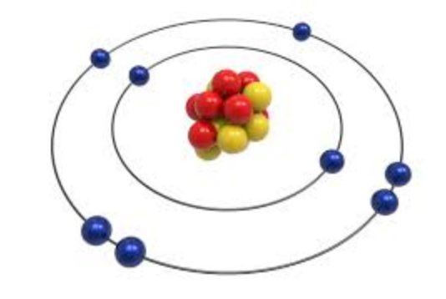
Descriptive Models
Abstractions of a system that already exists
Natural phenomena, legacy systems
Extracted through observation, experimentation (hypothesis testing) or reverse engineering

Slide 5
Descriptive Models
Understand how an existing system works
Generalise and make predictions

Slide 6
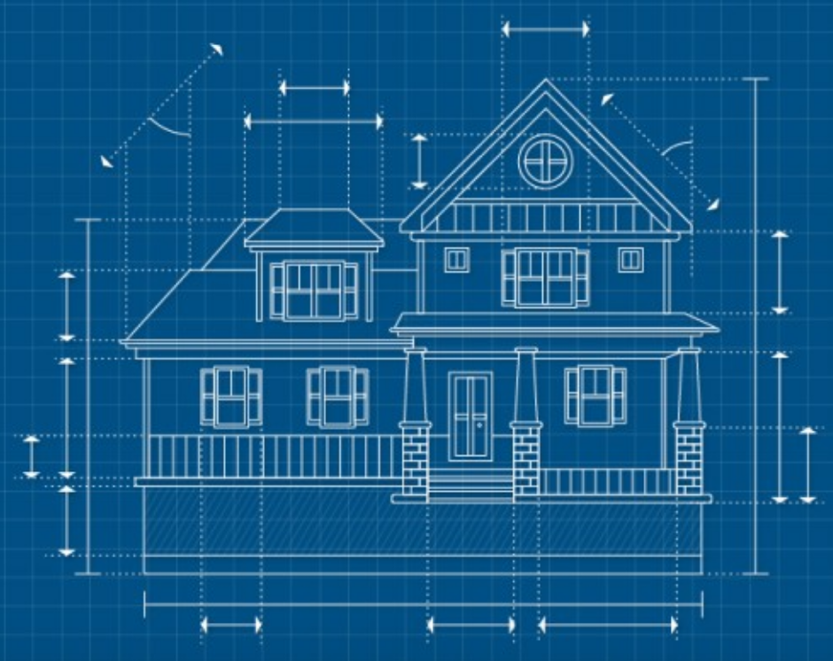
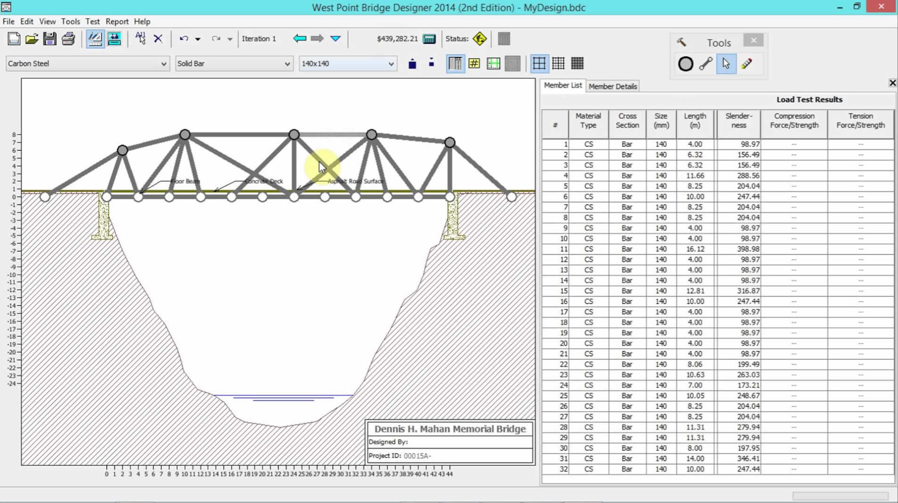
Prescriptive Models
Abstractions of a system that doesn’t exist yet
Define how the system should be implemented
Constructed manually (mostly)

Slide 7
Prescriptive Models
Investigate alternative designs
Discuss and verify properties of the system
… with less effort and more flexibility than building the actual system

Slide 8


Slide 9
Prescriptive models in software engineering

Slide 10
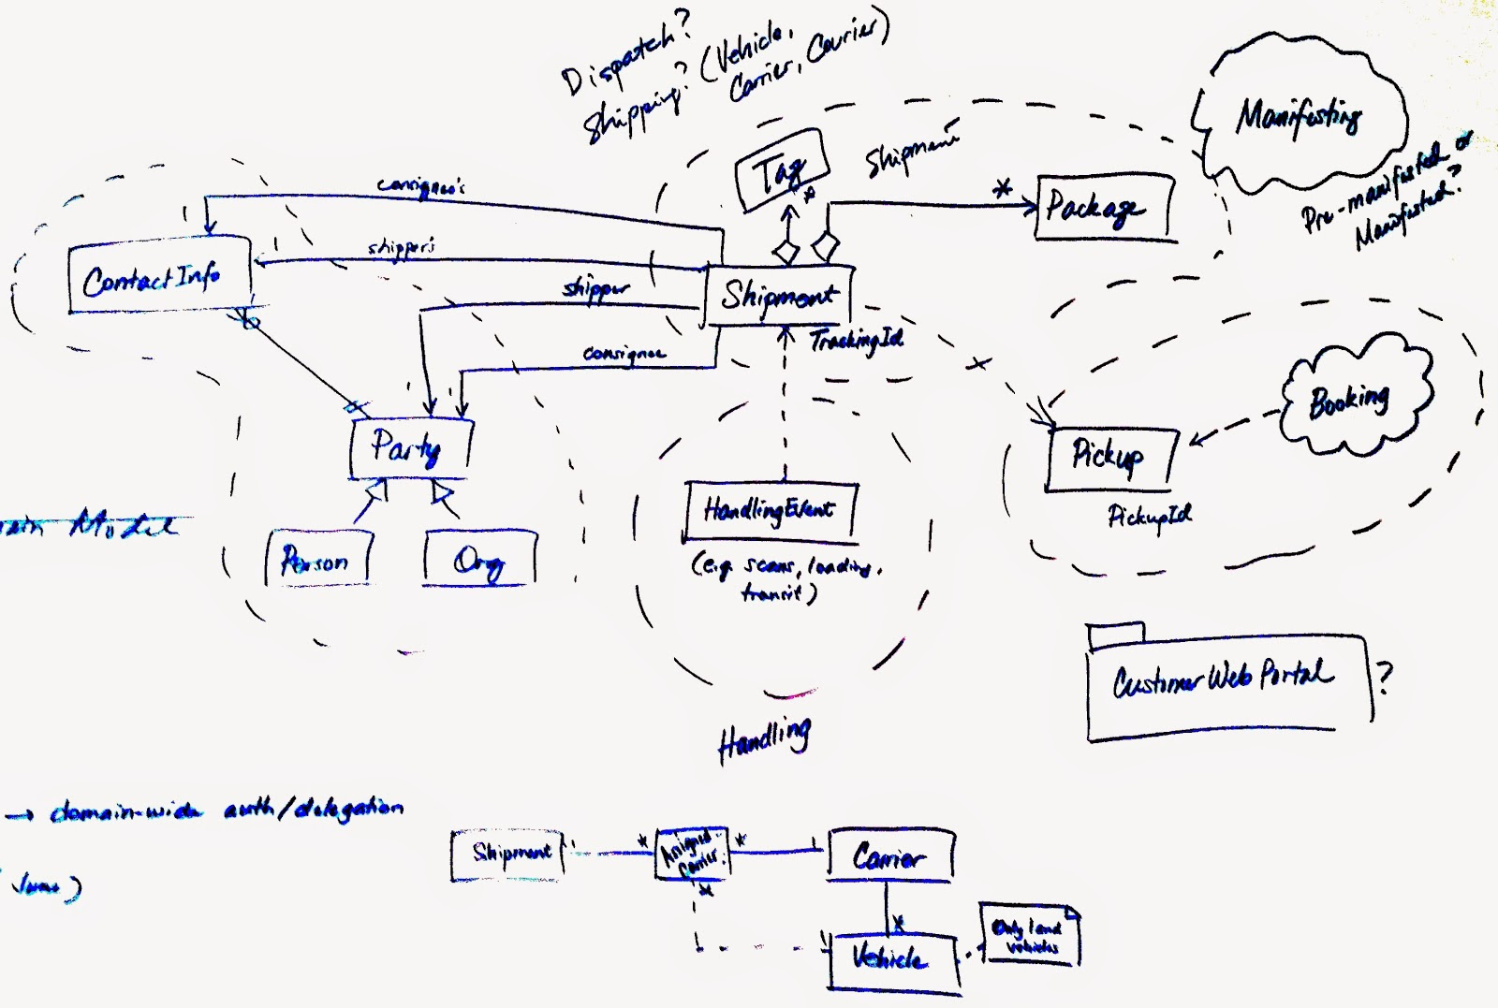
Prescriptive Models as Sketches
Facilitate informal discussion
Usually on paper/whiteboard
No strict notations/languages
Intentionally incomplete

Slide 11
Prescriptive Models as Blueprints
Complete and detailed specification of the system
Captured in languages with flexible semantics
Require human interpretation and manual implementation

Slide 12
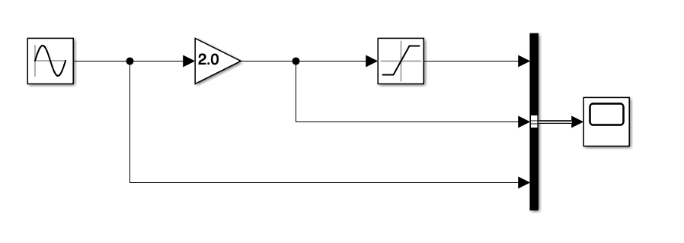
Prescriptive Models as Programs
Precise enough to drive automated system implementation/property verification
Captured in unambiguous (typically domain-specific) languages and machine-processable formats
Supported by executors, simulators, code generators

Slide 13
Software Modelling Languages
Unified Modelling Language (object-oriented systems)
SysML: UML extension for systems engineering
Simulink (control systems)
Archimate (enterprise architecture)
Business Process Model and Notation (business modelling)
ER (relational databases)
Domain-Specific Languages

Slide 14

Unified Modelling Language
Standardised graphical object-oriented modelling language
Can be used to model the structure and behaviour of a software system
Different types of diagrams for modeling structure and behaviour
Class diagrams, Sequence diagrams, State diagrams, Activity diagrams, Use Case diagrams etc.

Slide 15
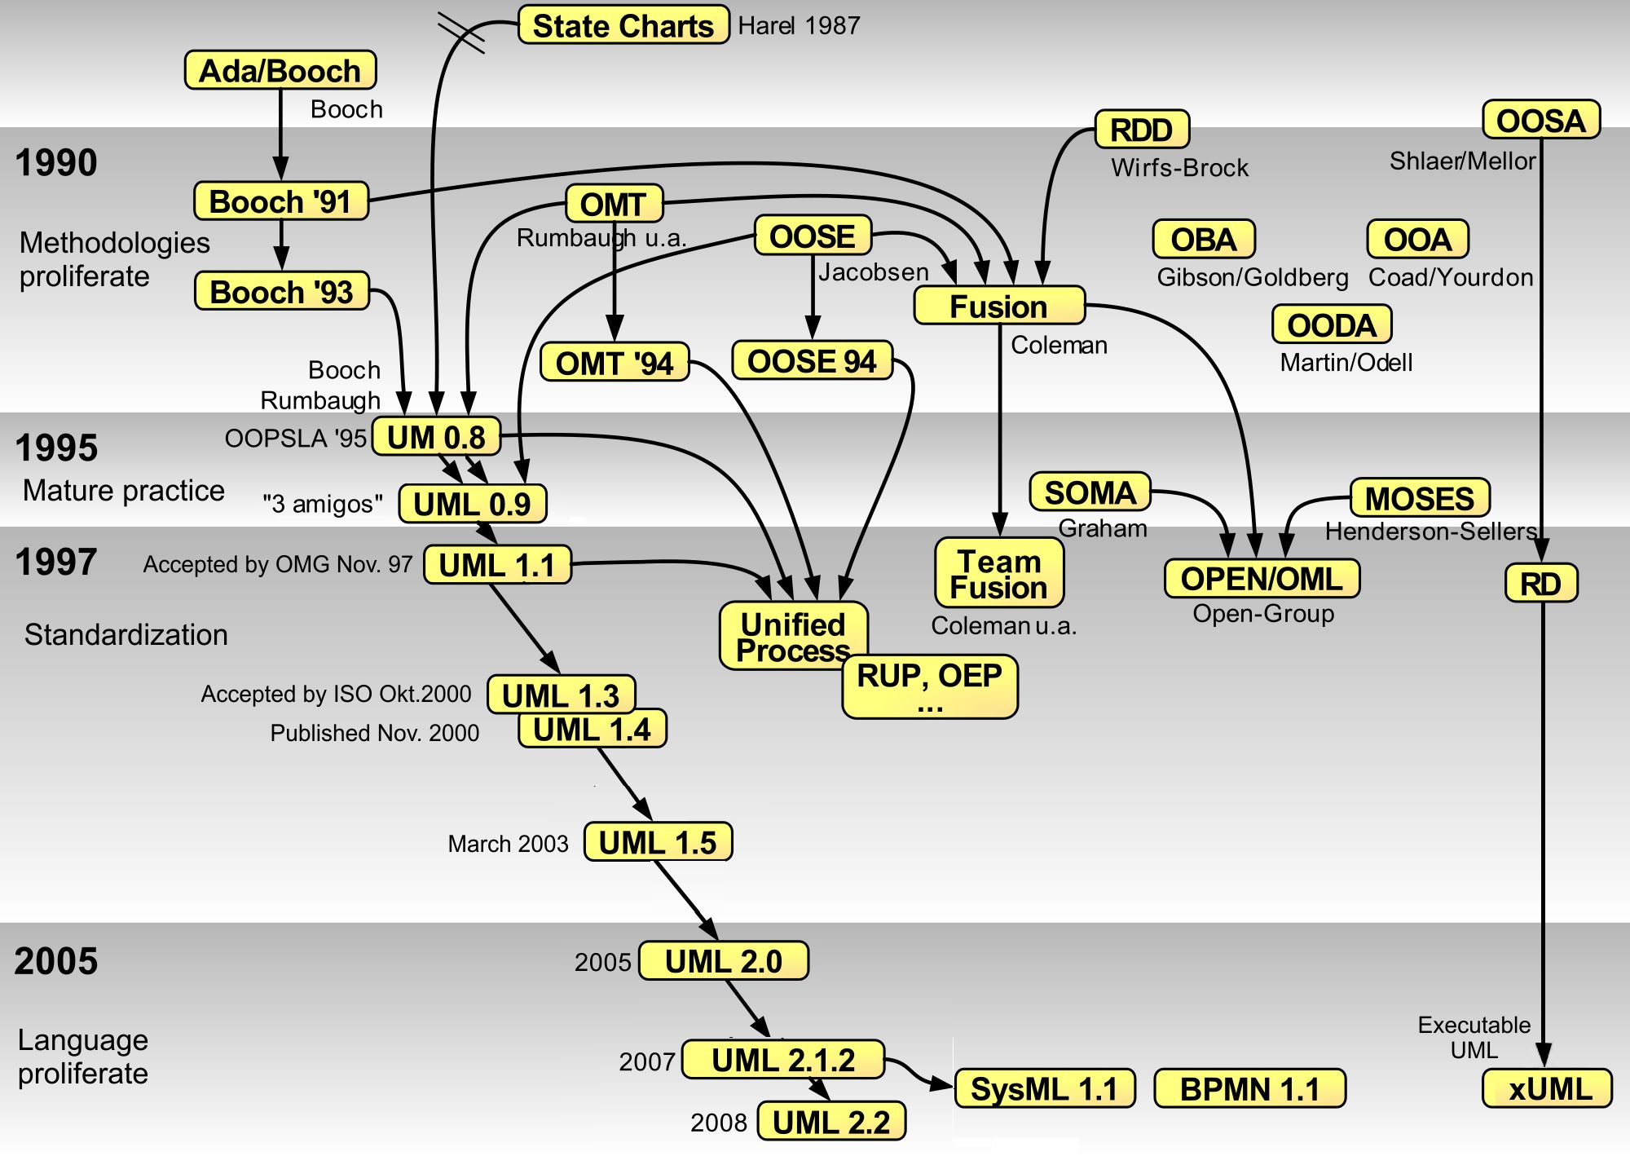
By Guido Zockoll, Axel Scheithauer & Marcel Douwe Dekker (Mdd) - Translation and update of File:OO-historie-2.svg by AxelScheithauer, Okt 6, 2009, CC BY-SA 3.0, https://commons.wikimedia.org/w/index.php?curid=23052855

Slide 16
UML Class Diagrams
Capture the structure of a system
Classes, attributes, operations, associations, inheritance and packages

Slide 17
UML Classes, Packages, Attributes, and Objects

Slide 18










Objects are Everywhere!
Notes:
In the object-oriented view of the world, everything is an object

Slide 19
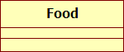
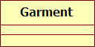
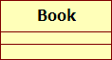
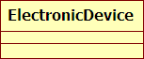
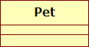
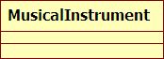
Tidying Up Objects: Classes

Slide 20
Real Objects vs. UML Classes
Objects = Real World Entities
Classes = Abstractions

Slide 21
UML Classes
A class is an abstraction over a number of similar real world objects
The name of a class
Is always a noun
Is always in singular
Always starts with an uppercase letter
Never contains spaces or other non-alphanumeric characters

Slide 22
Exercise
Which of the following are valid class names?
Bank
run
customer
Accounts
Withdraw
Credit card
John

Slide 23
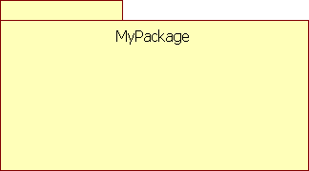
UML Packages
Used to group together related classes
Like folders are used to group files
Useful when number of classes in a model becomes too big
Can contain other packages too

Slide 24
Objects have Characteristics
English, 232 pages
Italian, 327 pages
French, 121 pages
Brown, omnivore
Strange, herbivore
Black, omnivore

Slide 25
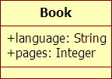
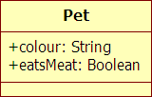
Classes have Attributes!
Objects = Real World Entities
Classes = Abstractions

Slide 26
UML Class Attributes
Each attribute has a name, a type, a multiplicity and a visibility
The name of an attribute
Is always a noun
Can be singular or plural
e.g. Book->authorNames
Always starts with a lowercase letter
Never contains spaces or other non-alphanumeric characters

Slide 27
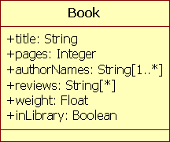
UML Class Attributes
The type of an attribute
Is always primitive
UML DataTypes: String, Integer, Float, Boolean
You can also add your own datatypes
Attribute multiplicity
Notation: [n] or [n..m]
* means any number of
Typical multiplicities are [*], [1..*]
Not specifying a multiplicity implies [1..1]

Slide 28
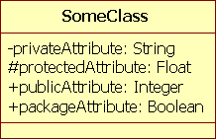
UML Class Attributes
Four types of visibility
Private: Accessible only to instances of the class
Symbol: -
Protected: Accessible only to instances of the class and any of its subclasses
Symbol: #
Public: Accessible to instances of any class
Symbol: +
Package: Accessible to instances of classes in the same package
Symbol: ~
Default is public
~

Slide 29
What to Leave Out
Classes have many potential attributes
Book: # of Pages, Language, Weight, Height, Title, Author(s), Material, AbilityToInduceInjury etc.
Choose those that are relevant to the problem you are modelling
Follow the YAGNI principle
You Ain’t Gonna Need It
If you need it you can add it later on anyway

Slide 30
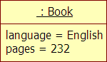
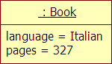
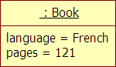
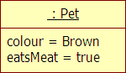
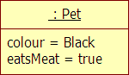
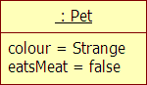
Real Objects vs. UML Objects

Slide 31
UML Objects vs. UML Classes
UML Objects
UML Classes
is an instance of
is the type of

Slide 32
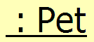
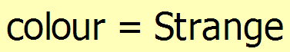
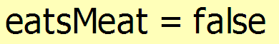
Anatomy of a UML Object
Type
Object
Slot
Slot

Slide 33
UML Objects vs. UML Classes
Each object is an instance of exactly one class
Each class can be the type of many objects
The name of a slot of an object must correspond to the name of an attribute of the object’s type (class)
Types must match too
Trivia: There are object oriented languages that allow objects to have more than one types

Slide 34
Finding Classes and Attributes
Start with a textual description of the system of interest
Locate nouns and noun phrases
Good candidate classes and attributes
Not all nouns are classes and attributes
Some classes and attributes may not be mentioned in the text

Slide 35
Example
Each bank has a name and customers. Each customer can have one or more accounts. Each account has a unique code and a balance. Customers can make cash withdrawals from their accounts using the ATM machines provided by the bank. To withdraw cash from an account, a customer needs to enter their card in an ATM and provide a correct PIN.

Slide 36
Example
Each bank has a name and customers. Each customer can have one or more accounts. Each account has a unique code and a balance. Customers can make cash withdrawals from their accounts using the ATM machines provided by the bank. To withdraw cash from an account, a customer needs to enter their card in an ATM and provide a correct PIN.

Slide 37
Example
Classes
Attributes
Bank
Account
Customer
Card
ATM
Withdrawal
bankName
accountBalance : Float
pinNumber : Integer
customerName
accountCode
customers : Customer[*]
numberOfAccounts : Intgeger
accounts : Account[1..*]

Slide 38
Inheritance and associations

Slide 39
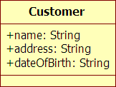
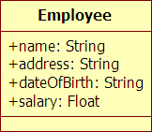
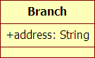
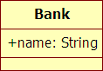
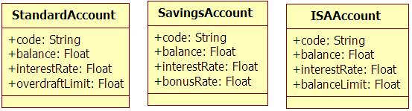
Bank Class Diagram

Slide 40
Bank Class Diagram

Slide 41
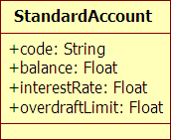
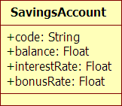
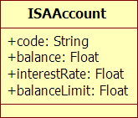
Problem #1: Duplication
Different classes have common attributes
If we need to change/add something, we need to do it in multiple places

Slide 42
Solution: Inheritance!
When a class A inherits a class B, A automatically gets all the features of B
All objects of type A must conceptually be also of type B
If A and B have a common subset of features then
A might need to become a sub-class of B
B might need to become a sub-class of A
A and B may need to become subclasses of a (new) class C
It may be incidental

Slide 43
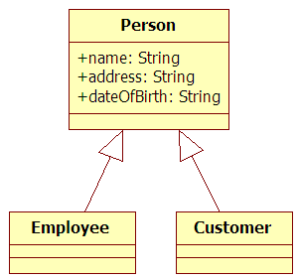

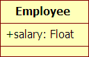
Inheritance in UML
Shown using a generalisation relationship
Line between classes, ending with a white closed arrow
End with arrow points at super-class
UML supports multiple inheritance
Valid terminology
Employee inherits from Person
Employee is a sub-class of Person
Person is a super-class of Employee (and Customer)

Slide 44
Exercise
Add inheritance to these classes to reduce duplication

Slide 45
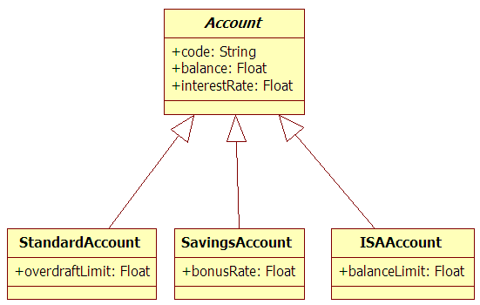
Solution

Slide 46
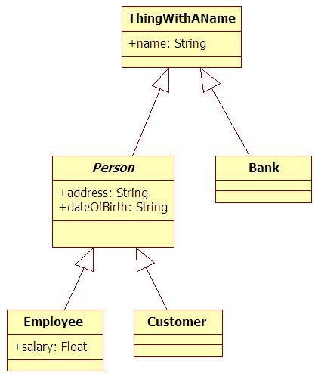
Don’t Overdo It
Common attributes don’t always imply inheritance
Don’t follow the “common attributes” rule blindly

Slide 47
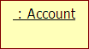

Abstract Classes
Generalisation often introduces new classes
e.g. the Person and Account classes in the previous example
Some of these classes are useful to simplify the design but cannot be instantiated: they are abstract.
The name of abstract classes appear in italics:

Slide 48
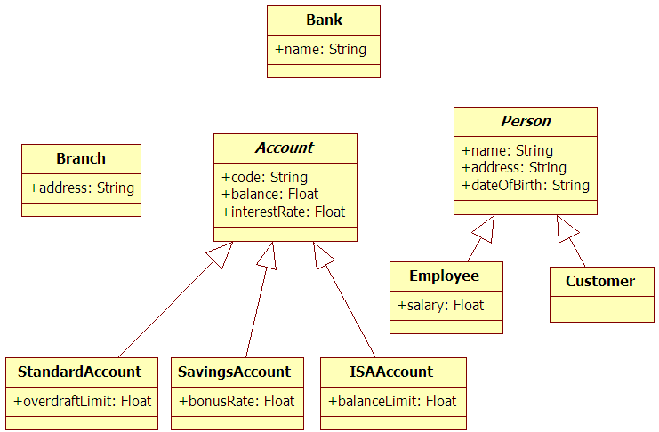
Problem #2: No relationships

Slide 49
Problem #2: No relationships
Customers have one or more accounts
Branches have one or more accounts
A bank has customers and employees
…
None of this is shown on our diagram

Slide 50
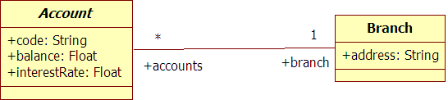
Solution: Associations!
Associations are used to show structural relationships between classes
Associations are visualised as lines that connect 2 classes
Each association has 2 ends
Each association end specifies
Name
Type
Multiplicity
Visibility

Slide 51
UML Association Ends
The name of an association end
Can be in singular or plural
But must match multiplicity
Always starts with a lowercase letter
Never contains spaces or other non-alphanumeric characters

Slide 52
UML Association Ends
The type of an association end is always another class
Not UML DataTypes: String, Integer, Float, Boolean
Association end multiplicity
Notation: n or n..m
* means any number of
Typical multiplicities are *, 1..*
Not specifying a multiplicity implies 1..1

Slide 53
Visibility in UML Association Ends
Four types of visibility
Private: Accessible only to instances of the class
Symbol: -
Protected: Accessible only to instances of the class and any of its subclasses
Symbol: #
Public: Accessible to instances of any class
Symbol: +
Package: Accessible to instances of classes in the same package
Symbol: ~
Default is public (same as in attributes)

Slide 54
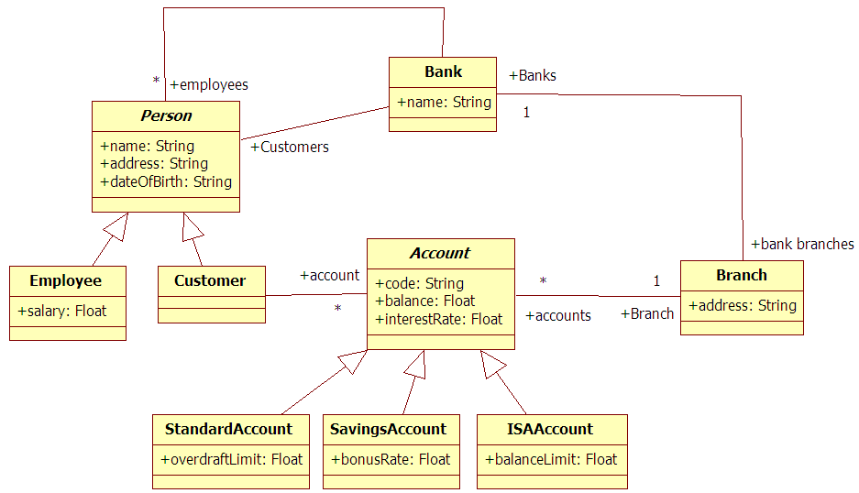
Updated Class Diagram

Slide 55
Correct Class Diagram
TBD in class.

Slide 56
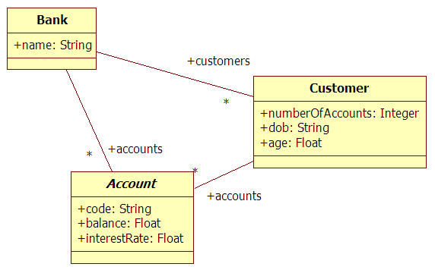
Avoiding Redundancy
Attributes and association ends may overlap semantically with each other
An attribute / association end is redundant if its value could be computed even if it was missing.

Slide 57
Redundant Association Ends and Attributes
TBD in Class

Slide 58
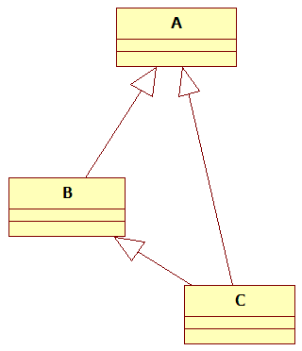
More Redundancy
Redundancy can also appear in inheritance
Can you spot it here?

Slide 59
UML Composition Associations
Special type of UML association
Indicates a strong containment relationship where the contained objects have no meaning/function outside the container.
Example
If a bank closes, all its branches also disappear (composition)
If a bank closes, nothing happens to its customers (normal association)

Slide 60
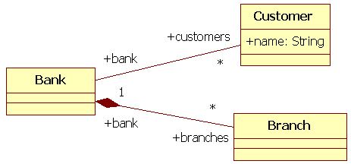
UML Composition Associations
Multiplicity
Strictly 1..x
Notation
Filled diamond at the end of the container
When unsure, use a simple association

Slide 61
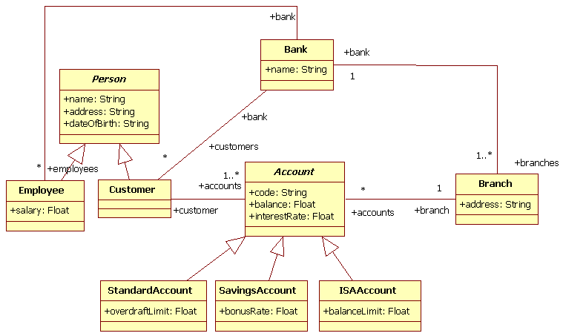
Exercise: Replace plain associations with compositions where applicable

Slide 62
Summary
Inheritance to reduce duplication (Is a…)
Line with filled white arrow
Duplicate attributes/association ends in different classes good indication that inheritance is needed
Exercise with caution
Associations to show structural relationships between classes (Has a…)
Plain line (no arrows)
2 ends with name, type, multiplicity and visibility
Special composition associations

Slide 63
A school has students and teachers. Each student takes a number of classes. Each teacher teaches at most 3 classes. The headmaster is also a teacher that is responsible for managing the rest of the teachers.

Slide 64
operations

Slide 66
UML Operations
Specify services that a class provides
Equivalent to methods in Java
Signature
<visibility> name (<parameters>) : <return-type>
Parameter
name : type
Example
UML: + order(product:Product, quantity:Integer) : Boolean
Java: public boolean order(Product product, int quantity)

Slide 67
Visibility in UML Operations
Four types of visibility
Private: Can be invoked only by instances of the class
Symbol: -
Protected: Can be invoked only by instances of the class and any of its subclasses
Symbol: #
Public: Can be invoked by instances of any class
Symbol: +
Package: Can be invoked only by instances of classes in the same package
Symbol: ~
Default is public (same as in attributes/association ends)

Slide 68
UML Operations
In programming languages methods specify a signature and a body
In UML, operations only specify a signature, not a body
Specifying the behaviour of a UML operation
Using behavioural diagrams
Specify how a call to an operation is propagated through objects in a running system
Using OCL post-conditions
Specify the effects of the operation, not how they are achieved
What as opposed to how

Slide 69
UML Operations
Finding operations
Operation names are usually verbs or verb phrases
Finding operation parameters
What does the operation need to know?
Finding owning class
Not always obvious which class an operation should belong to
Often more than one solutions are correct
But with different parameters

Slide 71
Example
“A customer can open an account at a branch of a bank.”
Candidate method name: openAccount()
Information needed to open an account
Customer the new account will belong to
Type of account (e.g. integer)
Branch

Slide 72
Possible Owners

Slide 73
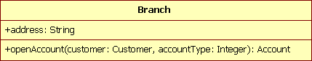
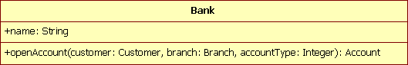
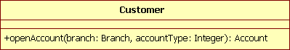
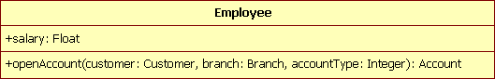
Possible Owners

Slide 74
Finding Owning Class
Things to consider
Does the class have the authority/responsibility to perform the operation?
Am I creating a “God class”?
i.e. a class that is responsible for everything that happens in the system
Evaluating alternatives
Fewer parameters win
Fewer required navigations win

Slide 75
Bank.openAccount()
Parameters
3
Does it have the authority/responsibility?
Yes

Slide 76
Customer.openAccount()
Parameters
2
Does it have the authority/responsibility?
No

Slide 77
Employee.openAccount()
Parameters
3
Does it have the authority/responsibility?
Not always (some employees do)

Slide 78
Branch.openAccount()
Parameters
2
Does it have the authority/responsibility?
Yes

Slide 79
Summary
 | # of parameters | Has authority/responsibility?
Bank | 3 | Yes
Customer | 2 | No
Employee | 3 | Not always
Branch | 2 | Yes
Branch.openAccount() wins
Fewer parameters
Has authority/responsibility

Slide 80
Exercise
“A customer can transfer a non-negative amount of money from one account to another.”
Find
Operation name
Information needed by the operation
Candidate owning classes
and parameters for each

Slide 81

Other UML Diagrams
Sequence diagrams
Activity diagrams
State diagrams
Collaboration diagrams
Use-case diagrams
Component diagrams

Slide 82
Sequence Diagrams
Class diagrams capture entities of the system, their features and relationships
Sequence diagrams capture interactions between entities in the system in a sequential order
Participants/objects
Lifelines
Messages

Slide 83
Sequence Diagrams
Support for alternative scenarios (alt) and loops
Should not be used as a programming language
Capture the gist of the behaviour, not its fine detail

Slide 84
State Diagrams
Capture the states of (a part of) the system and the events that trigger transitions between them
Also known as State Machines
What happens if an item is put on the scale before it is scanned/while assistance is provided?
All unexpected events trigger exceptional behaviour

Slide 85
Component Diagrams
Describe the decomposition of a system into communicating components

Slide 86
Architectural Modelling with UML
Structural diagrams
Component diagrams for high-level decomposition
Class diagrams to capture core entities, their features and relationships
No constructors, setters or getters
No dependencies on implementation language/library classes
Visibilities, composition/aggregation relationships not important at this stage
Behavioural diagrams
Sequence/activity diagrams for object communication
State diagrams to capture different system states

Slide 87
UML Tools
Dedicated UML tools
e.g. Visual Paradigm, StarUML, Eclipse Papyrus, ArgoUML
Textual modelling tools
e.g. PlantUML, UML Graph
Drawing tools with UML-like shapes
e.g. draw.io, Lucidchart
Reverse engineering tools
e.g. ObjectAid
Concerns
Enforcement of standard/correct UML notation, version control/collaboration

Slide 88
Lecture Summary
Discussed the value of models in (software) engineering
Prescriptive vs. Descriptive
Introduced the Unified Modelling Language and the different diagrams it provides
Class diagrams
Sequence diagrams
State diagrams
Component diagrams
Discussed architectural modelling with UML
Discussed criteria for selecting a UML tool

